Slide 1


HOUSING
AS
ECONOMIC INFRASTRUCTURE
President: Kevin Smith || Chief Development Officer: Brian Hutchinson

Slide 2


A Framework for
Community Investment
Today's Agenda
Our approach to housing and community development is simple and grounded in the belief that housing is economic infrastructure, not just a social service.
01
Who Is Community Ventures?
02
State of Housing and Our Vision for Lexington
03
Philosophy of Community Investment: Conventional vs. Innovative
206,000
$20M
$80M+
04
Community Ventures in Action
05
Feedback &
Conversation
Kentucky housing
gap today
Requested state investment
Total leveraged
investment (MET II)
2

Slide 3





MODULE 01 | WHO IS COMMUNITY VENTURES?
Our Origin Story
Founded to Serve
Became a CDFI
Expanded to Housing
Grew Statewide
Helped minority single mothers on public assistance start businesses and build economic independence.
Recognized the capital gap, created loan funds, and established Community Ventures as a certified CDFI.
Entered homeownership lending because ownership is the greatest wealth-builder for low-income families.
Moved into construction and renovation and expanded into other states by replicating proven models with the support of the New Markets Tax Credit.
3

Slide 4

MODULE 01 | CORE BELIEF
“
Everyone has a dream —
for a better life,
for their children,
for themselves.
This principle drives everything Community Ventures does. We tap into intrinsic motivation rather than prescribing solutions from the outside in.
4

Slide 5
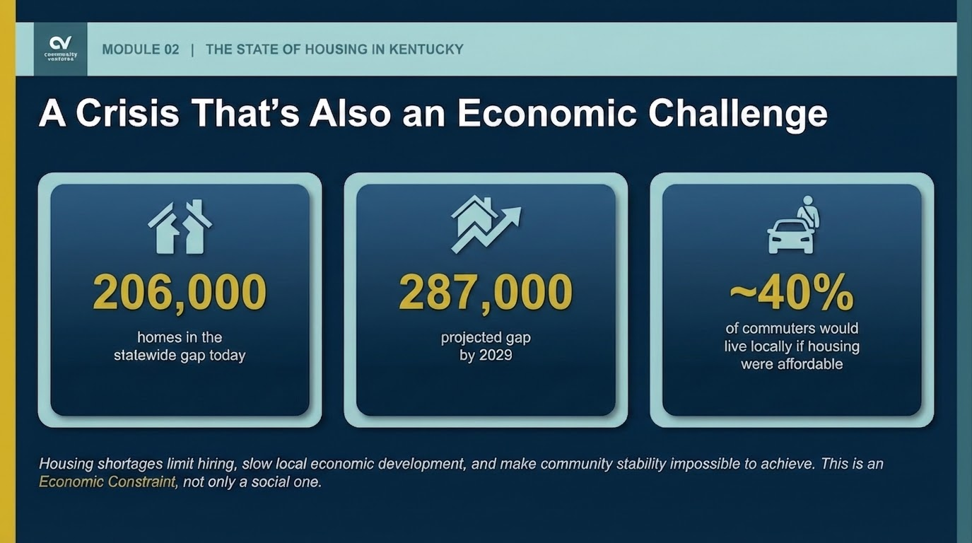
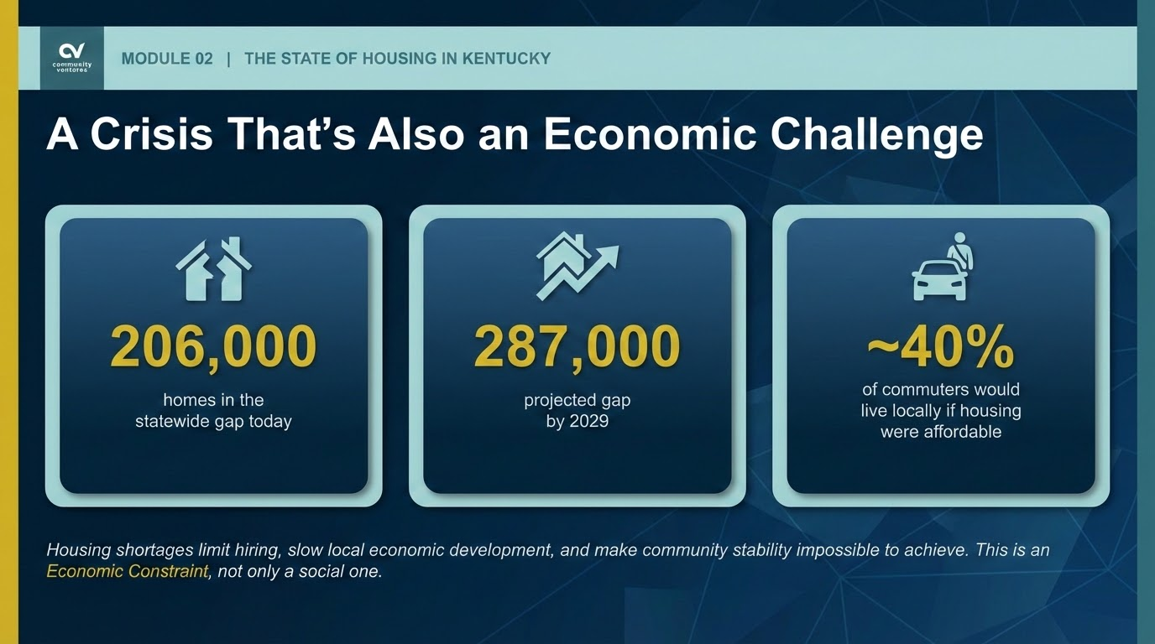

Slide 6
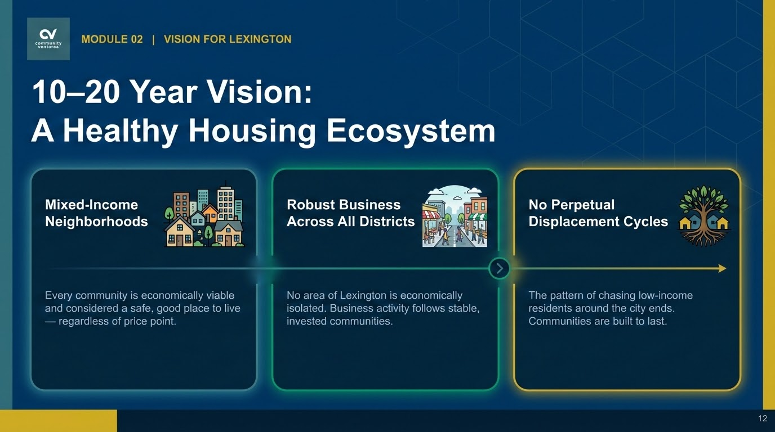

Slide 7
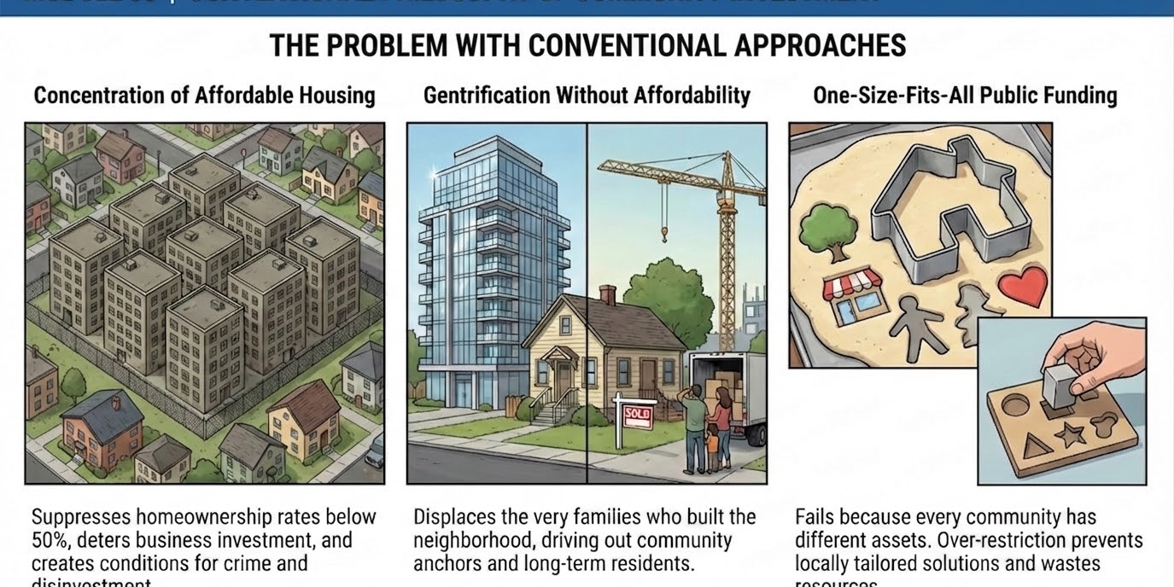
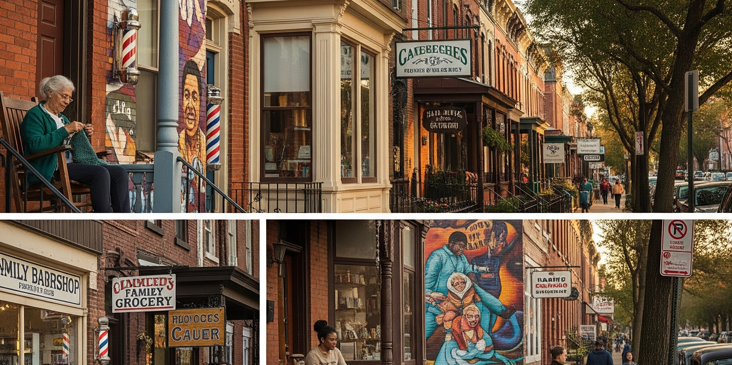

MODULE 03 | CONVENTIONAL PHILOSOPHY OF COMMUNITY INVESTMENT
The Problem With Conventional Approaches
Concentration of Affordable Housing
Gentrification Without Affordability
One-Size-Fits-All Public Funding
Suppresses homeownership rates below 50%, deters business investment, and creates conditions for crime and disinvestment.
Displaces the very families who built the neighborhood, driving out community anchors and long-term residents.
Fails because every community has different assets. Over-restriction prevents locally tailored solutions and wastes resources.
5

Slide 8
Why It Matters
MODULE 03
The 50%
Homeownership
Threshold
Above 50%: Homeowners invest in properties, generate spending, and attract quality businesses. Communities stabilize.
Below 50%: Predatory businesses fill the vacuum. Crime and disinvestment follow. The cycle is hard to reverse.
50%
The Opportunity: Communities below 50% homeownership should halt new rental permits until balance is restored. This forces new rental development into higher-ownership neighborhoods and prevents predatory businesses from coming in.
homeownership
tipping point
6

Slide 9
MODULE 03 | PLACEMAKING, NOT JUST HOUSING
Every Community Is Unique. We Should Honor That.
Buildings &
Infrastructure
Natural
Resources
Community
Landmarks
People &
Their Skills
Revitalization must be built on what already exists, lowering the cost of public investment and increasing long-term livability.
Case Study: Lexington's East End
Revitalization built on the community's history, the horse racing industry, and commercial vacancies. We capitalized on existing car traffic and the neighborhood's own artists to create livability across all income levels without requiring ongoing public subsidy.
8

Slide 10
MODULE 03 | THE MIXED-INCOME MODEL
Build Structural Affordability at the Start with No Ongoing Subsidy Required
70% Market Rate
30% Affordable
Market-rate rents permanently subsidize affordable units
No
Permanent
Zero
ongoing public subsidy
affordability by design
risk of units drifting up market after 15 years
7

Slide 11
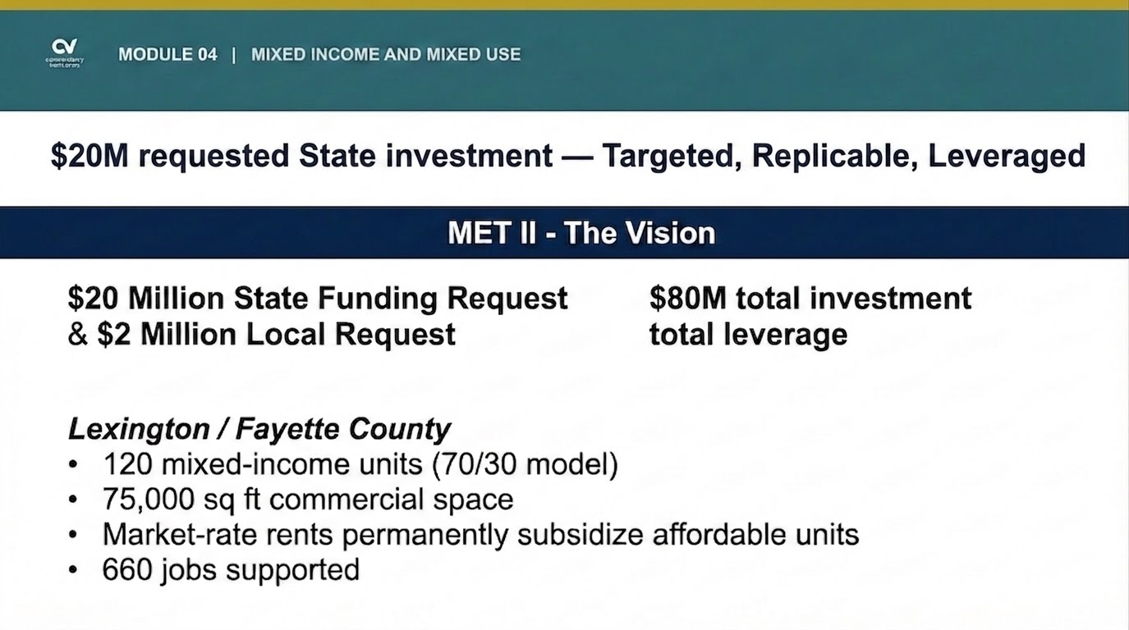

Slide 12
MODULE 04 | HOW LEVERAGE WORKS
One-Time Public Investment with Permanent Private Return
State Gap
Financing
Unlocks
Private Capital
Permanent
Affordable Asset
Proven Model:
Met
One-time appropriation — not recurring subsidy
Construction loans, permanent financing, tax credits, buyer participation
Housing that remains affordable — no future state support required
We’ve seen this work before.
$20 million in requested state investment and a requested $2 million in pre development catalyzes $80 million in total project value. That’s a 4:1 return on public dollars – without any recurring financial obligation.
11

Slide 13
MODULE 04 | THE POLICY LEVERS THAT GET US THERE
Six Principles for Transformative Housing Policy
1
Unify Community + Economic Development
2
Cross-Subsidize Without Ongoing Subsidy
3
Halt Rental Permits in Areas Below 50% Ownership
Treat them as one integrated strategy with shared goals and tear down the silos.
Mixed-income development funds affordability through market rents permanently.
Force new rental development into higher-ownership neighborhoods to restore balance.
4
5
Flexible Public Funding Mechanisms
6
Equitable Incubator Locations
Redefine Success Metrics
Small businesses from lower-income communities deserve the same desirable locations as high-income startups.
Allow locally tailored solutions. Overly restrictive and prescriptive funding wastes resources and fails communities.
Fund outcomes, not processes — allowing flexible use of public dollars that match local conditions, prioritizing economic contribution, stability, and the existing community inventory.
13

Slide 14
MODULE 05 | FEEDBACK & CONVERSATION
Your Perspective Matters
1
From your vantage point, what is the most pressing housing challenge in your district right now?
4
How do you think about the connection between affordable housing and economic development? Is that a relationship your constituents make?
2
When you think about housing investments in Lexington, what has worked well — and what has fallen short?
5
As you look at Community Ventures' approach, what resonates — and where do you see potential friction or concerns we should be aware of?
Are there neighborhoods in your district that have not received adequate development attention? What would meaningful investment look like there?
3
14

Slide 15
